Slide 1

Pre-Owned Car Price Prediction
CVR COLLEGE OF ENGINEERING​
Department of CSE-(AIML)
Team Members:
Munugala Prateeka – 22B81A6692
Busireddy Tejaswini – 22B81A66C0
Desu Om Keerthi – 22B81A6691
Project Guide: Mrs. Masarath Saba

Slide 2
Abstract
The Pre-Owned Car Price Prediction project aims to develop a machine learning model to predict the price of a pre-owned car based on its features and specifications.
With the rising demand for pre-owned vehicles, accurately determining a car's fair market value is crucial for buyers, sellers, and dealerships.
This project leverages historical car sales data, utilizing data analytics and machine learning techniques to estimate prices, making the valuation process efficient and data-driven.
The model minimizes human bias and inconsistencies by providing objective, data-driven price estimates, ensuring accuracy and transparency in car valuation.

Slide 3
Hardware and Software Requirements
Software Requirements:
Languages: Python, HTML, CSS, JavaScript
Framework: Flask
Tools/IDE: Visual Studio Code
Hardware Requirements:
System Specifications:
RAM: 8.00 GB
Hard disk: 4 GB
Operating System: Microsoft Windows 10 (64-bit)
Processor: Intel(R) Core(TM) i5-85205 CPU @ 1.60GHz 1.80 GHz

Slide 4



System Architecture
HTML/CSS/JavaScript
HTML/CSS/JavaScript for UI
Flask: Backend framework
Pre-processing: Data cleaning
ML Model: Price prediction
Dataset: Car sales data
Output: Predicted price
Backend Server
Flask framework
Data
Pre-processing
Machine Learning
Model
Predicted
Output
Car Dataset

Slide 5
Block Diagram
Data Collection
Features: Car age, brand, model, mileage, fuel type, transmission, etc.
Handling Missing Values
Encoding Categorical Data (e.g., One-Hot Encoding, Label Encoding)
Feature Scaling (Standardization/Normalization)
Splitting Data (Train-Test Split)
Data Pre-processing
Exploratory Data Analysis (EDA)
Data Visualization (scatter plots, correlation heatmaps)
Identifying trends and patterns
Model Selection
Algorithms: Linear Regression, Decision Tree, Random Forest, etc.
Choosing based on data characteristics
Model Training
Feeding training data into the selected model
Learning the relationship between features and target
Model Evaluation
Metrics: MAE, MSE, RMSE, R² Score
Cross-validation for reliable results
Price Prediction
Predicting car prices using the trained model
Integration
Flask Web App for user-friendly interaction
Integration with frontend (HTML, CSS, JS)

Slide 6
Functional Requirements
User Input Handling: Allow users to input car details such as make, model, year of manufacture,
mileage, engine size, fuel type, and transmission type.
Data Preprocessing: Clean, normalize, and transform raw input data to a suitable format for the
machine learning model.
Price Prediction: Use the trained machine learning model to predict the price of a pre-owned car
based on the provided input features.
User Interface (UI): Provide an intuitive, easy-to-use web interface for users to enter car details and
view predicted prices.
Backend Processing: Handle data flow between the frontend UI and the machine learning model
using Flask for seamless interaction.
Result Display: Display the predicted car price clearly and accurately on the user interface after
processing the input.

Slide 7
Non Functional Requirements
Performance: The system should provide price predictions within 2-3 seconds after user input.
Scalability: The system should handle an increasing number of users and larger datasets without
performance degradation.
Reliability: The system must ensure consistent and accurate predictions, minimizing errors even
with new data.
Usability: The front-end should be user-friendly, with an intuitive interface for smooth navigation.
Maintainability: The codebase should be modular and well-structured, making it easy to update
the model or add new features.
Portability: The system should work seamlessly across different devices and browsers without
compatibility issues.

Slide 8
Dataset Description
The dataset contains information about pre-owned cars in the Indian market, comprising 15,000 entries with 11 detailed attributes. The data appears to be collected up to November 2024, providing a comprehensive view of the second-hand car market in India.
Dataset Features
Brand: Car manufacturer (e.g., Maruti Suzuki, Honda, Tata, BMW) Model: Specific car model (e.g., Innova, Swift) Year: Manufacturing year of the vehicle (ranging from older models to 2024) Age: Age of the vehicle in years kmDriven: Total kilometers driven by the vehicle Transmission: Type of transmission (Manual or Automatic) Owner: Ownership status (first or second owner) FuelType: Type of fuel (Petrol, Diesel, Hybrid/CNG) PostedDate: When the car listing was posted AdditionalInfo: Extra details about the vehicle AskPrice: Listed price in Indian Rupees (₹)

Slide 9
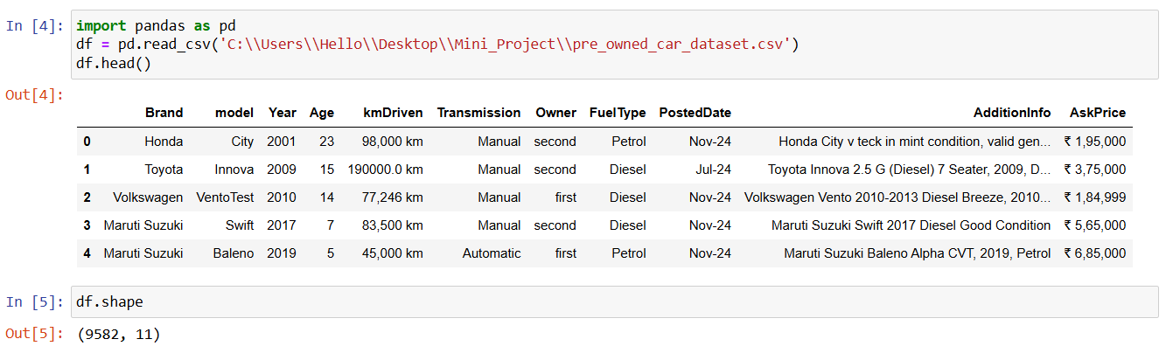
.
Dataset Statistics
Total entries: 14,993
Columns: 11
Memory usage: 1.94+ MB
Data types: Mixed (int64 and object)

Slide 10


Algorithm/ Model Used
.
The problem of price prediction deals with continuous variables which makes it suited to regression algorithms, but by creating discrete intervals for the continuous variables such as price, other algorithms could be applied.
Linear Regression
Linear regression assumes that there is a linear relationship between the input features (car attributes such as brand, model, age, mileage, etc.) and the output (car price).
The model tries to find the best-fitting line that minimizes the difference between the predicted values and the actual values.
$\hat{y}$​ is the predicted price of the car
$β0$​ is the intercept term (bias).
$β1,β\text{2},$​,…, $βp$​ are the coefficients (weights) of the features which represent the influence of each feature on the predicted price.

Slide 11
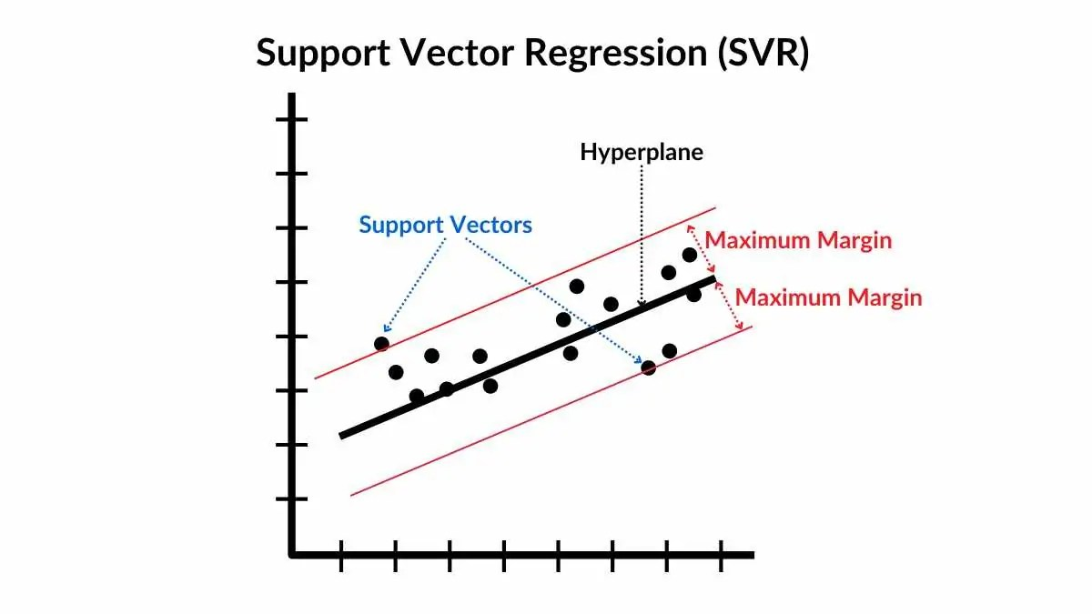
.
Support Vector Regression
Support Vector Regression (SVR) is a type of regression algorithm based on the principles of Support Vector Machines (SVM).
Unlike traditional regression models that aim to minimize the error between predicted and actual values, SVR tries to fit the best possible line (or hyperplane) within a defined margin of tolerance, known as ε (epsilon).
from sklearn.svm import SVR

Slide 12
.
Gradient Boosting Regression (GBR)
Gradient Boosting Regression (GBR) is an ensemble learning technique that builds models sequentially.
Each new model attempts to correct the errors made by the previous models. The final prediction is the combined output of all models, making it highly accurate for regression tasks like car price prediction.
from sklearn.ensemble import GradientBoostingRegressor
XGBoost (Extreme Gradient Boosting)
XGBoost is an advanced version of Gradient Boosting that’s designed for speed and performance.
Also builds trees sequentially but adds regularization (L1 & L2) to prevent overfitting.
import xgboost as xgb

Slide 13


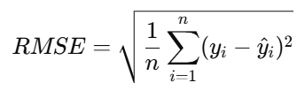
Evaluation metrics
1. Mean Absolute Error (MAE)
MAE measures the average magnitude of the errors in a set of predictions, without considering their direction (i.e., it does not penalize over-predictions and under-predictions differently).
2. Mean Squared Error (MSE)
MSE measures the average squared difference between the actual and predicted values. It penalizes larger errors more than MAE due to the squaring operation.
3. Root Mean Squared Error (RMSE)
RMSE is the square root of the MSE, bringing the error metric back to the original unit of measurement (in this case, car price).

Slide 14



Accuracy
Accuracy measures the proportion of correct predictions (both positive and negative) out of all predictions made.
TP (True Positive): Correctly predicted positive cases
TN (True Negative): Correctly predicted negative cases
FP (False Positive): Incorrectly predicted as positive
FN (False Negative): Incorrectly predicted as negative
Precision (Positive Predictive Value)
Precision measures how many of the predicted positive results are actually correct.
Recall (Sensitivity or True Positive Rate)
Recall measures how many of the actual positive cases your model correctly identified.

Slide 15
Addressing of Overfitting, Underfitting
Train-Test Split and Cross-Validation
Split data into training and testing sets to evaluate model generalization.
Use cross-validation to obtain a more reliable estimate of model performance and reduce overfitting.
Ex: K-Fold Cross-Validation
Helps balance model complexity, avoiding overfitting and underfitting.
Model Selection
Start with simple models, progressively increasing complexity if necessary.
Evaluate models on training and validation sets.
If the model performs poorly on both, increase complexity. If it performs well on training but poorly on test data, the model is likely overfitting and needs simplification.

Slide 16
THANK YOU

